Slide 1
Logistic Regression
Aniket Roy :- 18162121029
Krutik SHAH :- 18162121029

Slide 2
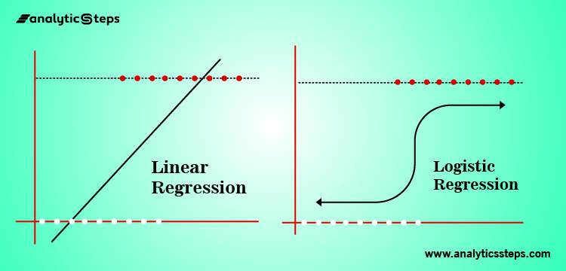
Why logistic regression?

Slide 3
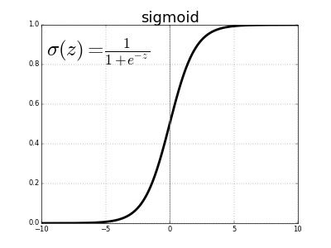
Sigmoid function

Slide 4
Our problems can be divided into single class and multiclass
Single class/ Binary
1. Email classification: spam or not
2. Tumor: malignant or benign
Multiclass
Hand printed Number detection
Face classification

Slide 5
Linear regression
Linear regression is used for regression or to predict continuous values whereas logistic regression can be used both in classification and regression problems but it is widely used as classification algorithm
The main difference that makes both different from each other is when the dependent variables are binary, logistic regression is considered and when dependent variables are continuous, then linear regression is used.

Slide 6
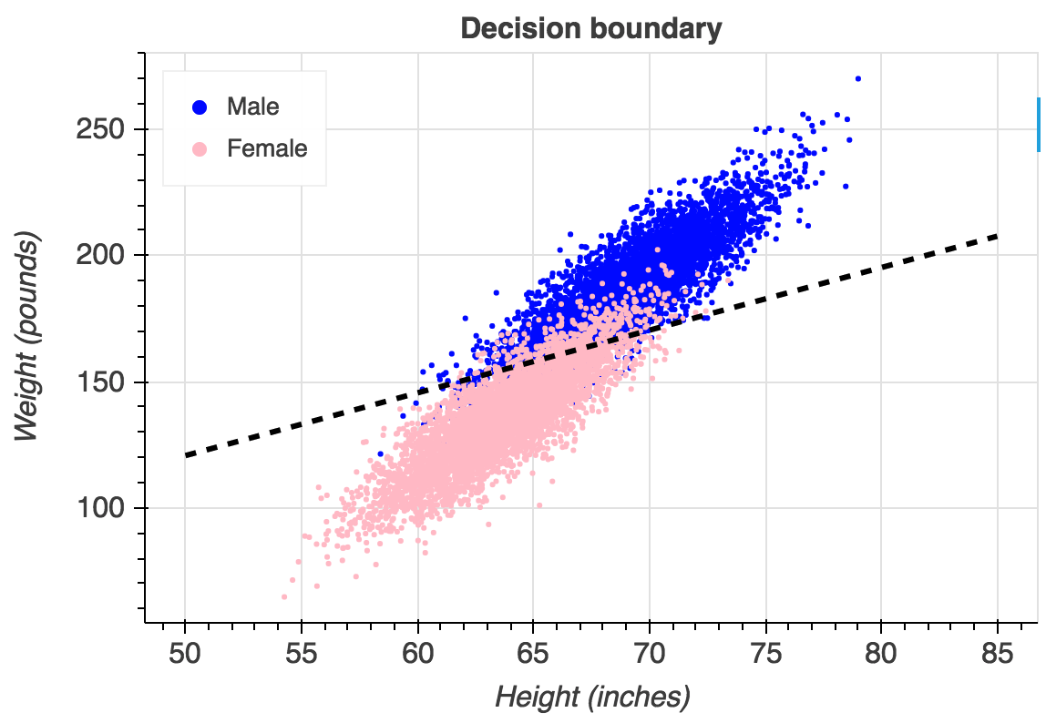
Gender prediction from height

Slide 7
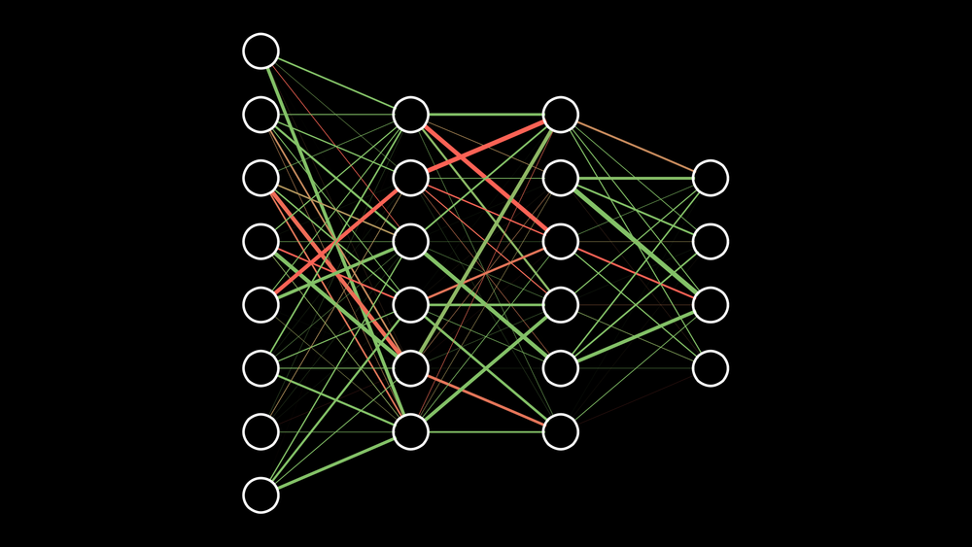
Multivariate Logistic regression

Slide 8
Multivariate Logistic regression examples
Neural Network
Hand digit Recognition
Face detection
Object classification

